Slide 1
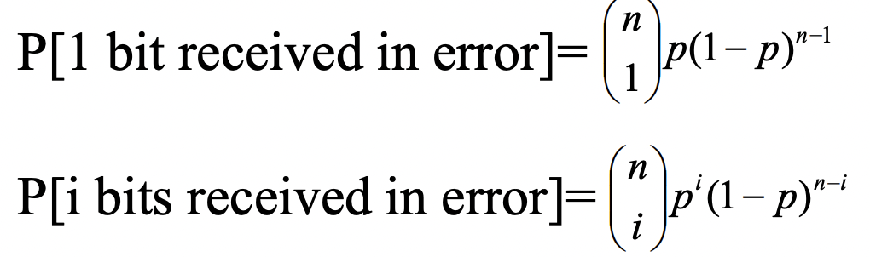
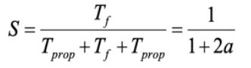
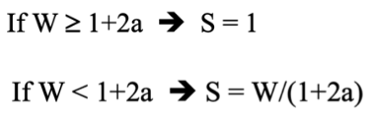
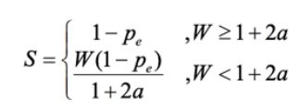
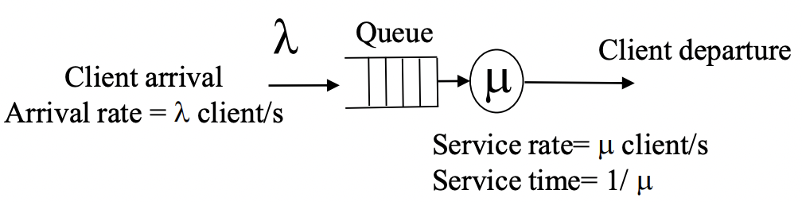
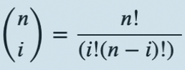
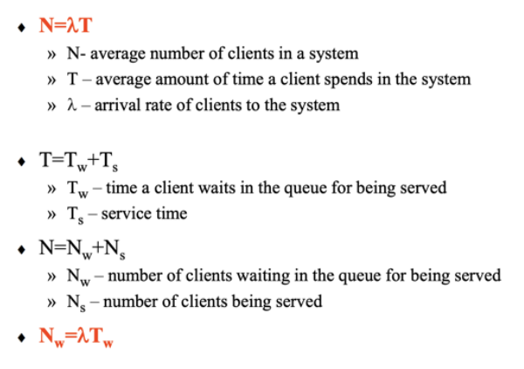
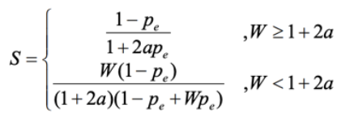
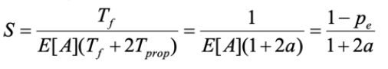
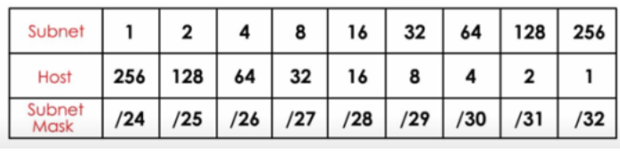
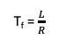
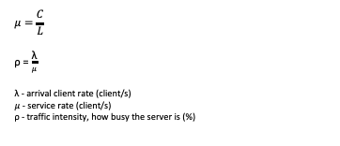
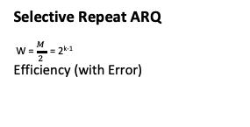
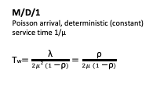
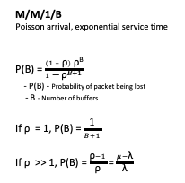
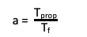
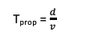
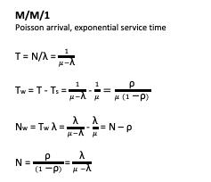
T_{f} = $\frac{L}{R}$
T_{prop} = $\frac{d}{v}$
Stop and Wait ARQ
Efficiency
Efficiency (with Error)
Go-Back-N ARQ
W = M-1 = 2^{k} -1
Efficiency
Efficiency (with Error)
Selective Repeat ARQ
W = $\frac{M}{2}$ = 2^{k-1}
Efficiency (with Error)
P[frame has no errors] = (1-p)^{n}
P[frame has errors]= FER = P_{e} = 1-(1-p)^{n}
a = $\frac{\text{T}\text{prop}}{\text{T}\text{f}}$
C_{max}= R x S
$$μ=\frac{C}{L}$$
$\text{ρ}$ = $\frac{\text{λ}}{μ}$
$\text{λ}$ - arrival client rate (client/s)
$μ$ - service rate (client/s)
$\text{ρ}$ - traffic intensity, how busy the server is (%)
M/M/1
Poisson arrival, exponential service time
T = N/λ = $\frac{1}{μ−\text{λ}}$
T_{w} = T - T_{s} = $\frac{1}{μ−\text{λ}}$ - $\frac{1}{μ}=\frac{\text{ρ}}{μ (1\text{ − }\text{ρ})}$
N_{w} = T_{w} $\text{λ}$ = $\frac{\text{λ}}{μ−\text{λ}}$ - $\frac{\text{λ}}{μ}$ = N – $\text{ρ}$
N = $\frac{\text{ρ}}{ (1\text{ − }\text{ρ})}$ = $\frac{\text{λ}}{μ −\text{λ}}$
M/M/1/B
Poisson arrival, exponential service time
P(B) = $\frac{\left(1 – \text{ρ}\right) \text{ρ}\text{B}}{1\text{ − } {\text{ρ}}^{B+1} }$
- P(B) - Probability of packet being lost
- B - Number of buffers
If $\text{ρ}$ = 1, P(B) = $\frac{\text{1}}{B+1}$
If $\text{ρ}$ >> 1, P(B) = $\frac{\text{ρ}−1}{\text{ρ}}$ = $\frac{μ−\text{λ}}{\text{λ}}$
M/D/1
Poisson arrival, deterministic (constant) service time 1/μ
T_{w}$=\frac{\text{λ}}{2μ2 (1\text{ − }\text{ρ})}=\frac{\text{ρ}}{2μ (1\text{ − }\text{ρ})}$
Kendall Notation
A/S/s/K
A – arrival
S – service
s - number of servers
K – buffer capacity
Probability of queue having n clients
P(n) = ρ^{n} (1-ρ)
P(n) - probability of the Markov chain be in state n
n - number of clients in the queue

Slide 2
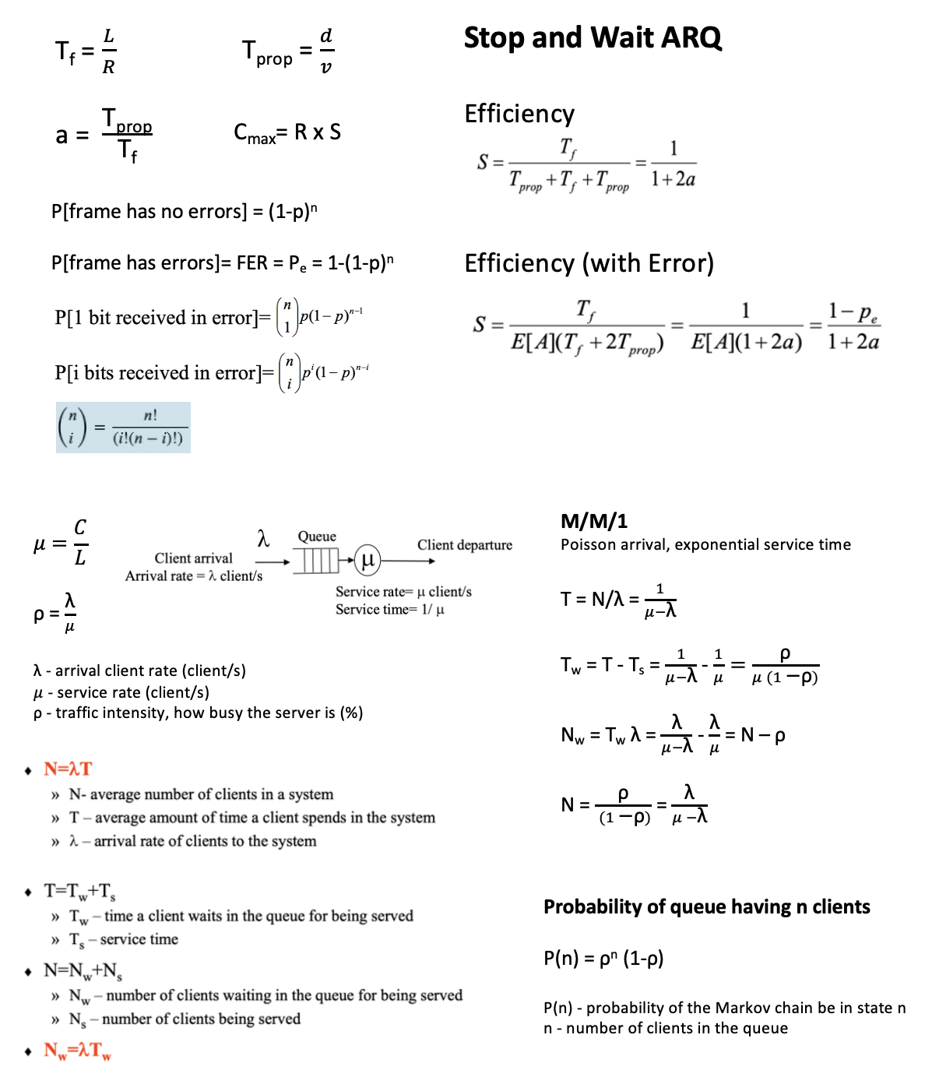
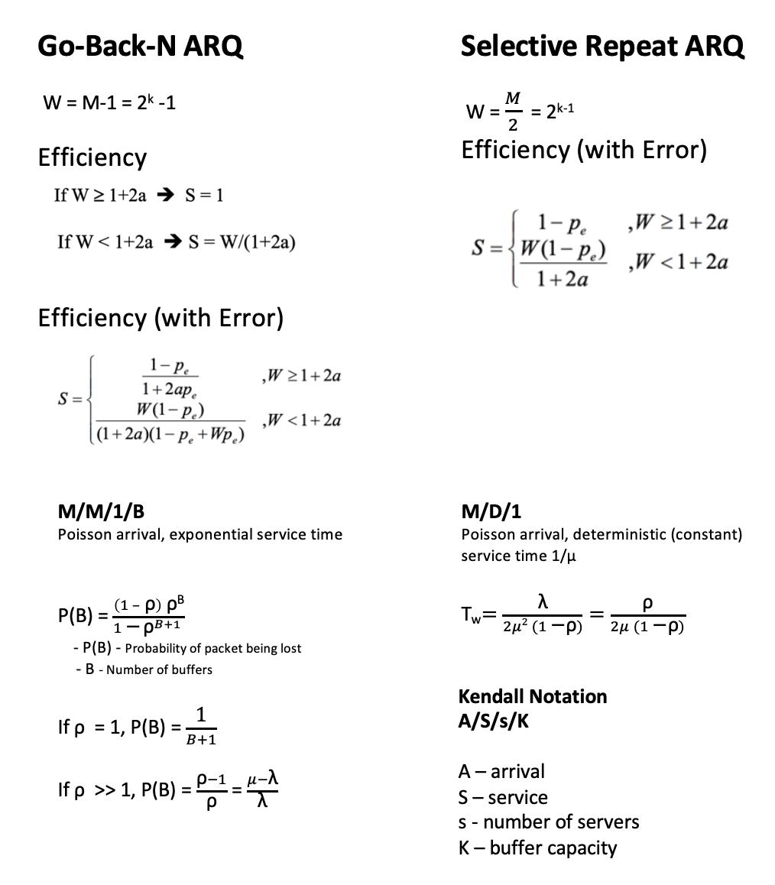
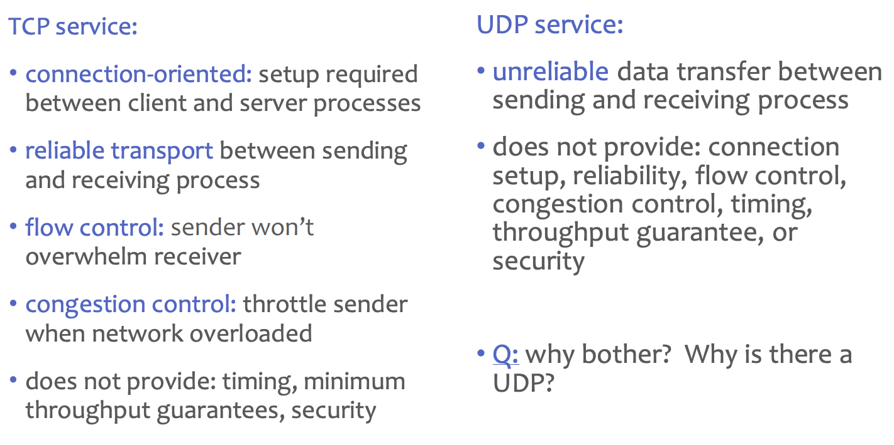
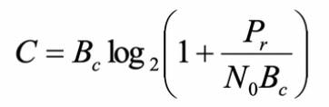
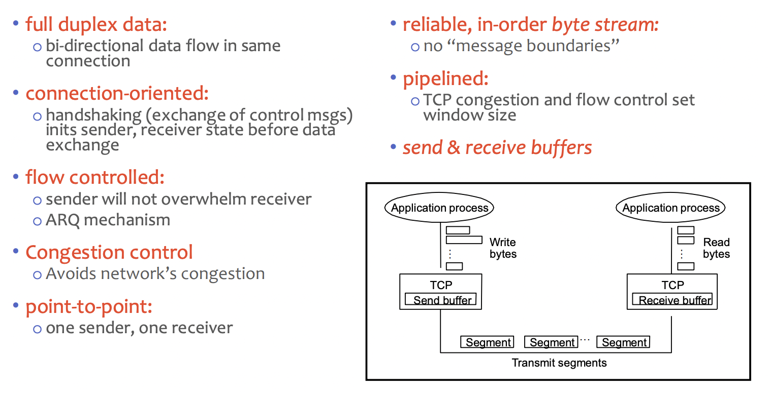
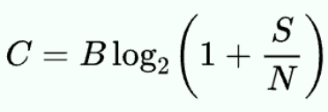
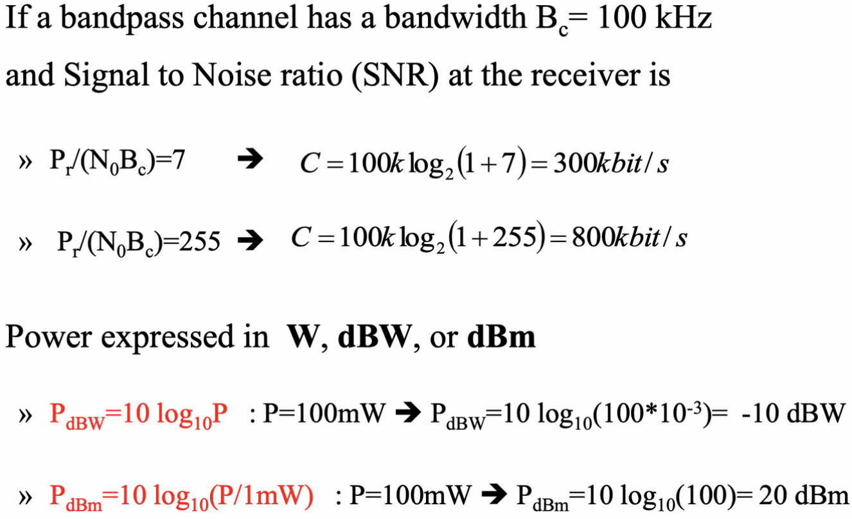
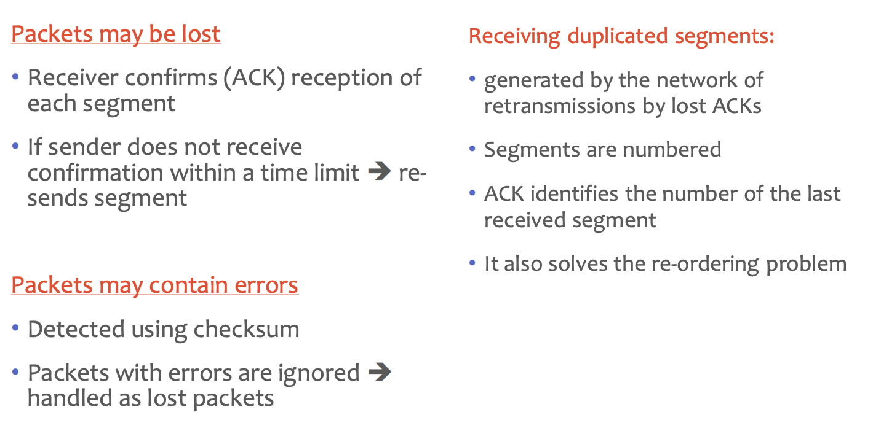
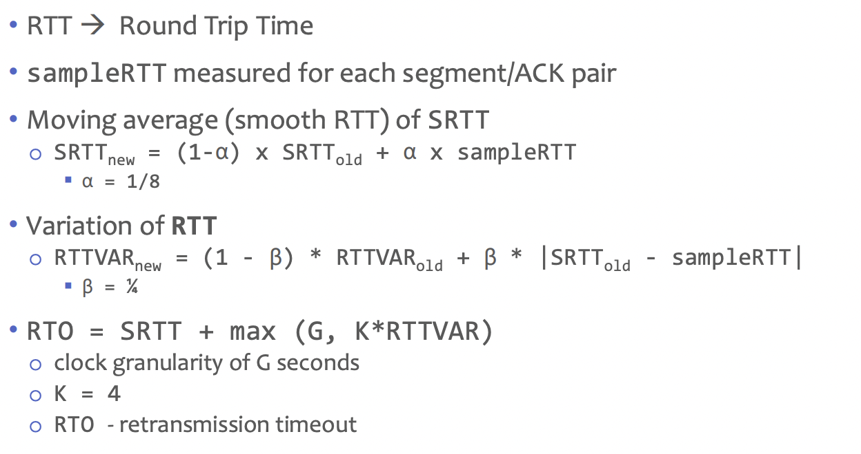
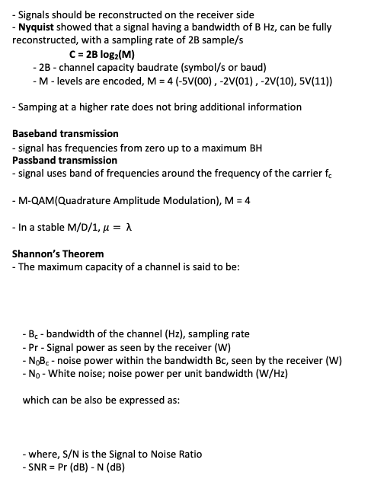
Internet transport-layer protocols
UDP - User Datagram Protocol (UDP)
• Allows applications
- to interface directly to IP
- with minimal additional protocol overhead
• often used for streaming multimedia apps
- loss tolerant
- rate sensitive
• other UDP uses
- DNS
- SNMP
• reliable transfer over UDP: add reliability at application layer
- application-specific error recovery!
TCP – Transmission Control Protocol
- Signals should be reconstructed on the receiver side
- Nyquist showed that a signal having a bandwidth of B Hz, can be fully reconstructed, with a sampling rate of 2B sample/s
C = 2B log₂(M)
- 2B - channel capacity baudrate (symbol/s or baud)
- M - levels are encoded, M = 4 (-5V(00) , -2V(01) , -2V(10), 5V(11))
- Samping at a higher rate does not bring additional information
Baseband transmission
- signal has frequencies from zero up to a maximum BH
Passband transmission
- signal uses band of frequencies around the frequency of the carrier f_{c}
- M-QAM(Quadrature Amplitude Modulation), M = 4
- In a stable M/D/1, $μ= \text{λ}$
Shannon’s Theorem
- The maximum capacity of a channel is said to be:
- B_{c} - bandwidth of the channel (Hz), sampling rate
- Pr - Signal power as seen by the receiver (W)
- N₀B_{c} - noise power within the bandwidth Bc, seen by the receiver (W)
- N₀ - White noise; noise power per unit bandwidth (W/Hz)
which can be also be expressed as:
- where, S/N is the Signal to Noise Ratio
- SNR = Pr (dB) - N (dB)

Slide 3
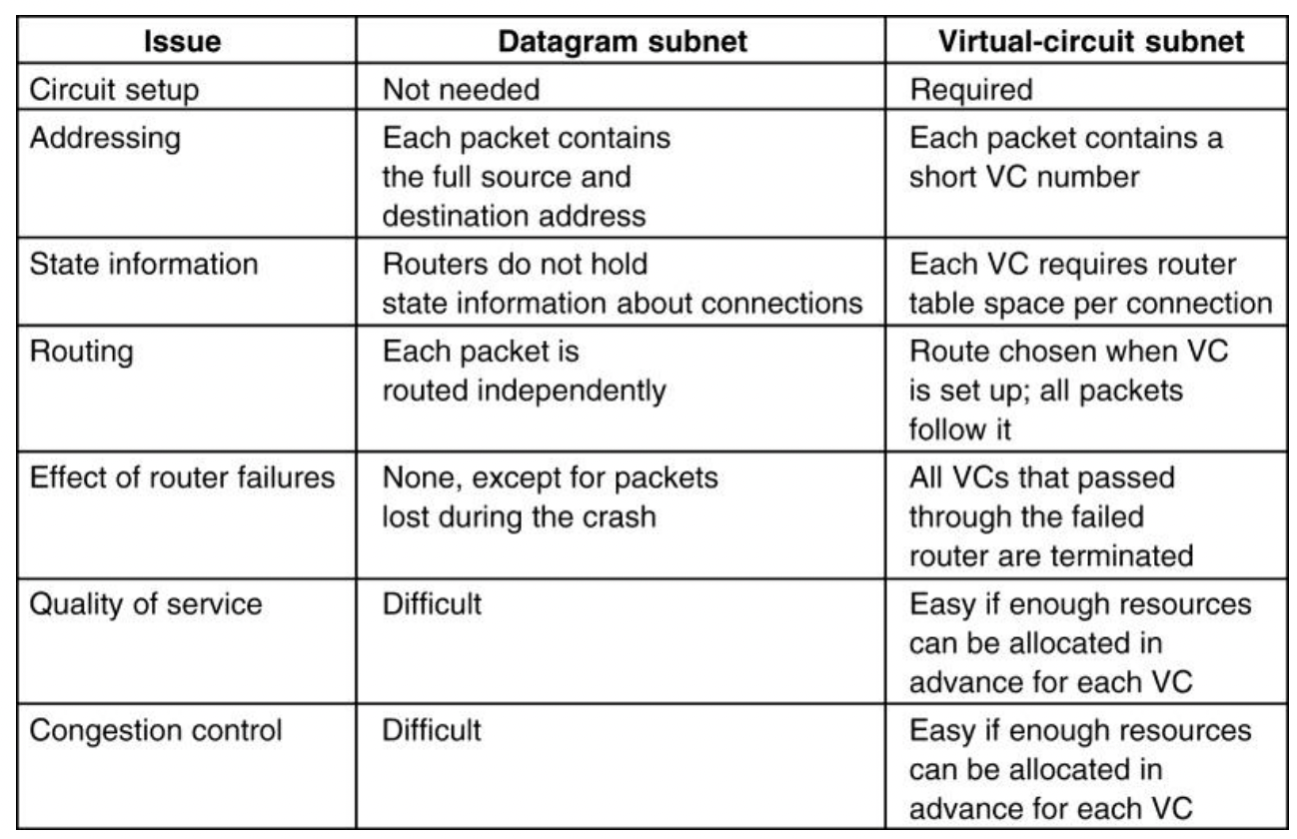
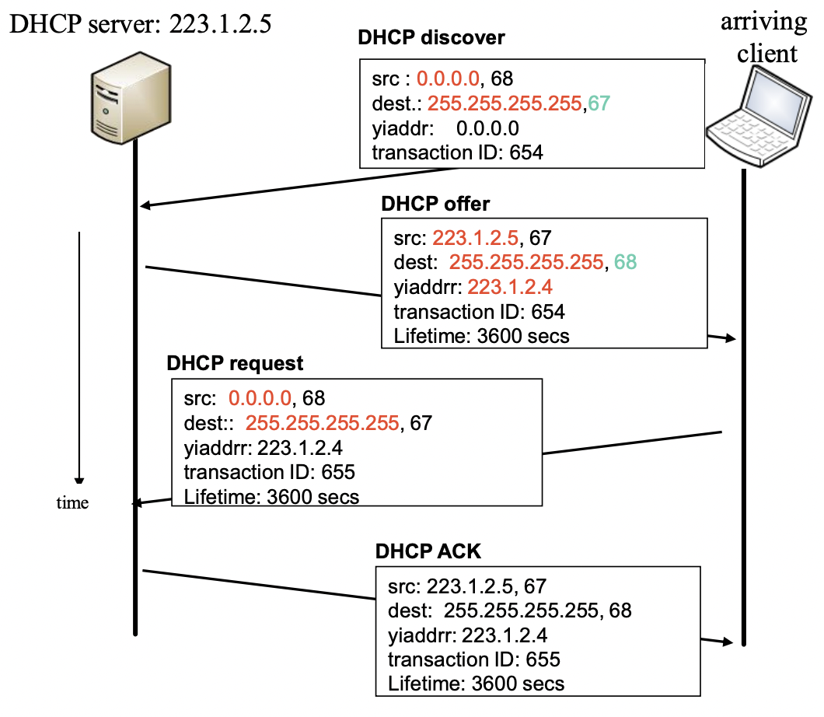
MAC
Datalink has 2 sub-layers:
- LLC (Logical Link Control)
- interface for network layer, error and flow control
- Error and flow control
- MAC (Medium Access Control)
- Access control to the shared medium
- Frame transmission/reception
- Addressing and Error control
ideal Multiple Access Protocol
- one station wants to transmit -> it uses the R bit/s
- m stations want to transmit -> each station uses an average rate R/m bit/s
MAC Protocols:
- Channel Partitioning
- Time Division Multiplexing | Frequency Division Multiplexing
- Random Access
- channel not divided, collisions allowed
- Taking turns
- stations take turns
- stations with more data to send can take longer turns
Channel partitioning
MAC protocols (TDM, FDM)
» share channel efficiently and fairly at high loads
» are inefficient at low loads
- delay in channel access; 1/N bandwidth allocated even if only 1 active node!
Random access MAC protocols (Aloha, CSMA, CSMA/CD, CSMA/CA)
» efficient at low load -> single node can fully utilize the channel
» high load -> collisions -> inefficiency
Taking turns protocols
» look for best of both worlds!
What Are Random Access Protocols?
- When station has packet to send
- transmits at channel data rate R bit/s
- no a priori coordination among stations
- If two or more stations transmit simultaneously ➜ collision
- It defines:
- when to send data
- how to detect collision
- how to recover from collisions
- Examples:
- ALOHA, CSMA, CSMA/CD, CSMA/CA
1. ALOHA
- When packet transmission fails, it will delay a random period of time before next transmission
- Pure Aloha (unslotted)
- Station transmits when it has a frame to transmit
- S_{max} = 18.4%
- Slotted Aloha
- Time divided into time slots
- Tslot = Tframe
- (Re)transmissions only the beginning of a slot
- S_{max} = 36.8%
2. CSMA (Carrier Sense Multiple Access)
- Listens before transmit
- If channel sensed free → transmit frame
- If channel sensed busy → defer transmission
- Collisions can still occur (entire packet is lost)
- vulnerability time = 2*Tprop = rtt (round trip time)
- Determine collision probability
- a = T_{prop}/T_{frame} <<1
3. CSMA/CD – Carrier Sense Multiple Access / Collision Detection
- Carrier Sense
- station senses medium before transmitting
- If free → station starts transmission
- If busy → waits until free and then transmits
- Collision Detection
- station listens medium while transmitting
- if collision is detected
- transmission is aborted
- retransmission delayed using
- a Binary Exponential Back-off algorithm
- time modeled in time slots; Tslot= 2*Tprop
- after the ith consecutive collision → the station attempts to transmit, after waiting, a random number of slots uniformly distributed in [0, 2^i-1]
- No ACK is needed
- It can detect itself for collisions
- however, a minimum frame size is required for collision detection
4. CSMA/CA - CSMA with Collision Avoidance
- CSMA/CD cannot be used for wireless transmission
- Therefore it is more commonly used in wireless networking
- CSMA / CA is effective before a collision.
- whereas, CSMA/CD is effective after a collision.
- Station with a frame to transmit
- monitors the channel activity → until an idle period equal to a Distributed Inter-Frame Space (DIFS) has been observed
- then if medium remains free → transmits frame
- If the medium is sensed busy
- random backoff interval is selected
- backoff time counter is decremented as long as the channel is sensed idle
- stopped when a transmission is detected on the channel
- reactivated when the channel is sensed idle again for more than a DIFS
- the station transmits when the backoff time reaches 0
- to avoid channel capture
- station waits random backoff time between two consecutive frame transmissions
- even if the medium is sensed idle in the DIFS time
- ACK will be required for CSMA/CA
- Since it cannot locally detect if there is a collision
- S_{max} = 60% commonly found
Taking turns Mac Protocols
1. Polling
- master station invites slave stations to transmit in turn
- concerns
- polling overhead
- latency
- single point of failure (master)
2. Token Passing
» control token
- passed from one station to next sequentially
» token message
» concerns
- token overhead
- latency
- single point of failure (token)
Hub
- Has repeaters, repeats bits received on one port to all other ports
- Layer 1 device (does not know addresses)
- if collision detected on one port -> repeats random bits on other port
- 1 Collision Domain and half duplex
Bridge
» Layer 2 device
» forwards MAC frames to destinations based on MAC addresses
» Packet received on one port -> analyzed by bridge -> re-sent on some other port
» Bridge separates collision domains
- a bridged LAN maybe larger than a repeated LAN
- several frames may be transmitted simultaneously
Note: Switches not need a MAC Address (transparent bridging), but routers do have.
Services provided by network layer
Virtual Circuit network Datagram network
- connection-oriented service - connectionless service
Virtual Circuit
circuit establishment
data transference
circuit termination
- Packet carries identifier of Virtual Circuit
- Path defined from source to destination
-sequence of VC identifiers, one for each link along path
- Router
-maintains “state” for every supported circuit
-may allocate resources (bandwidth, buffers) per Virtual Circuit
Datagram
- No circuit establishment; no circuit concept
- Packets
-forwarded using destination host address
-packets between same source-destination pair may follow different paths
What is ARP needed for?
- On the same LAN you need to connect on the link layer
- Known: IP address of destination (packet from Network Layer)
- Unknown: MAC address of destination
- Protocol used to obtain the MAC address associated to a given IP address
- RARP – Reverse ARP - Protocol used to obtain the IP address associated to a MAC address
DHCP allows
- host to dynamically obtain its IP address (assigns a dynamic IP address) from network server when it joins network
- It supports address reuse
NAT
- To overcome IP address shortage
- Uses private IP address
- Converts an internal private IP address and port to a public one, to be used in the public network
ICMP - Internet Control Message Protocol
- Ping request
- Used by router or host
- to send layer 3 error or control messages
- to other hosts or routers
- Carried in IP datagrams
• Link-Local
Used for communication between hosts in the same LAN/link
Address built from MAC address
Routers do not forward packets having Link-Local destination addresses
• Global Unicast
Global addresses
Address: network prefix + computer identifier
Structured prefixes
Network aggregation; less entries in the router forwarding tables
• Anycast
Group address; packet is received by any (only one) member of the group
• Multicast
Group address; packet received by all the members of the group

